Slide 1
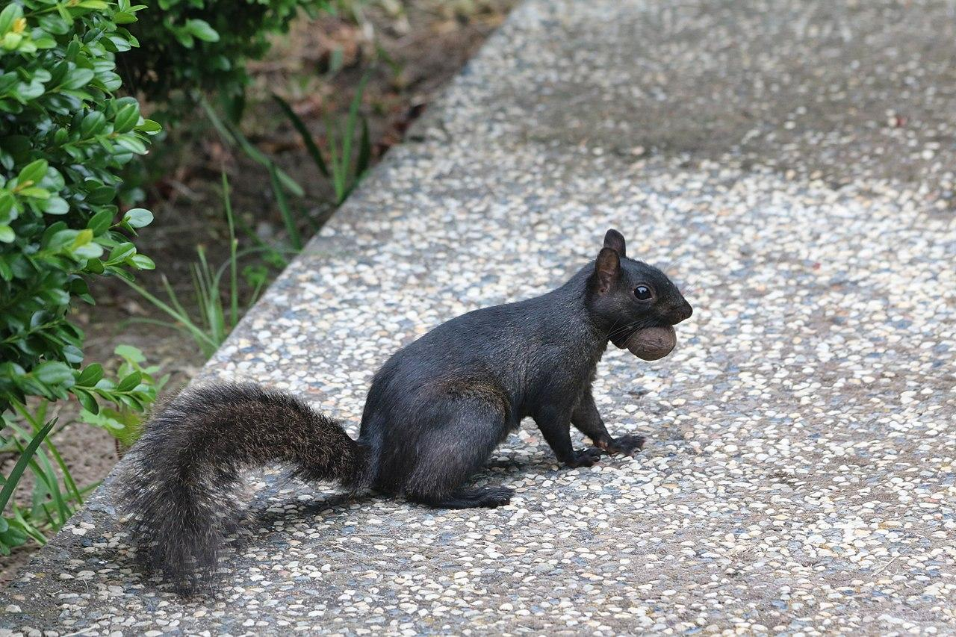
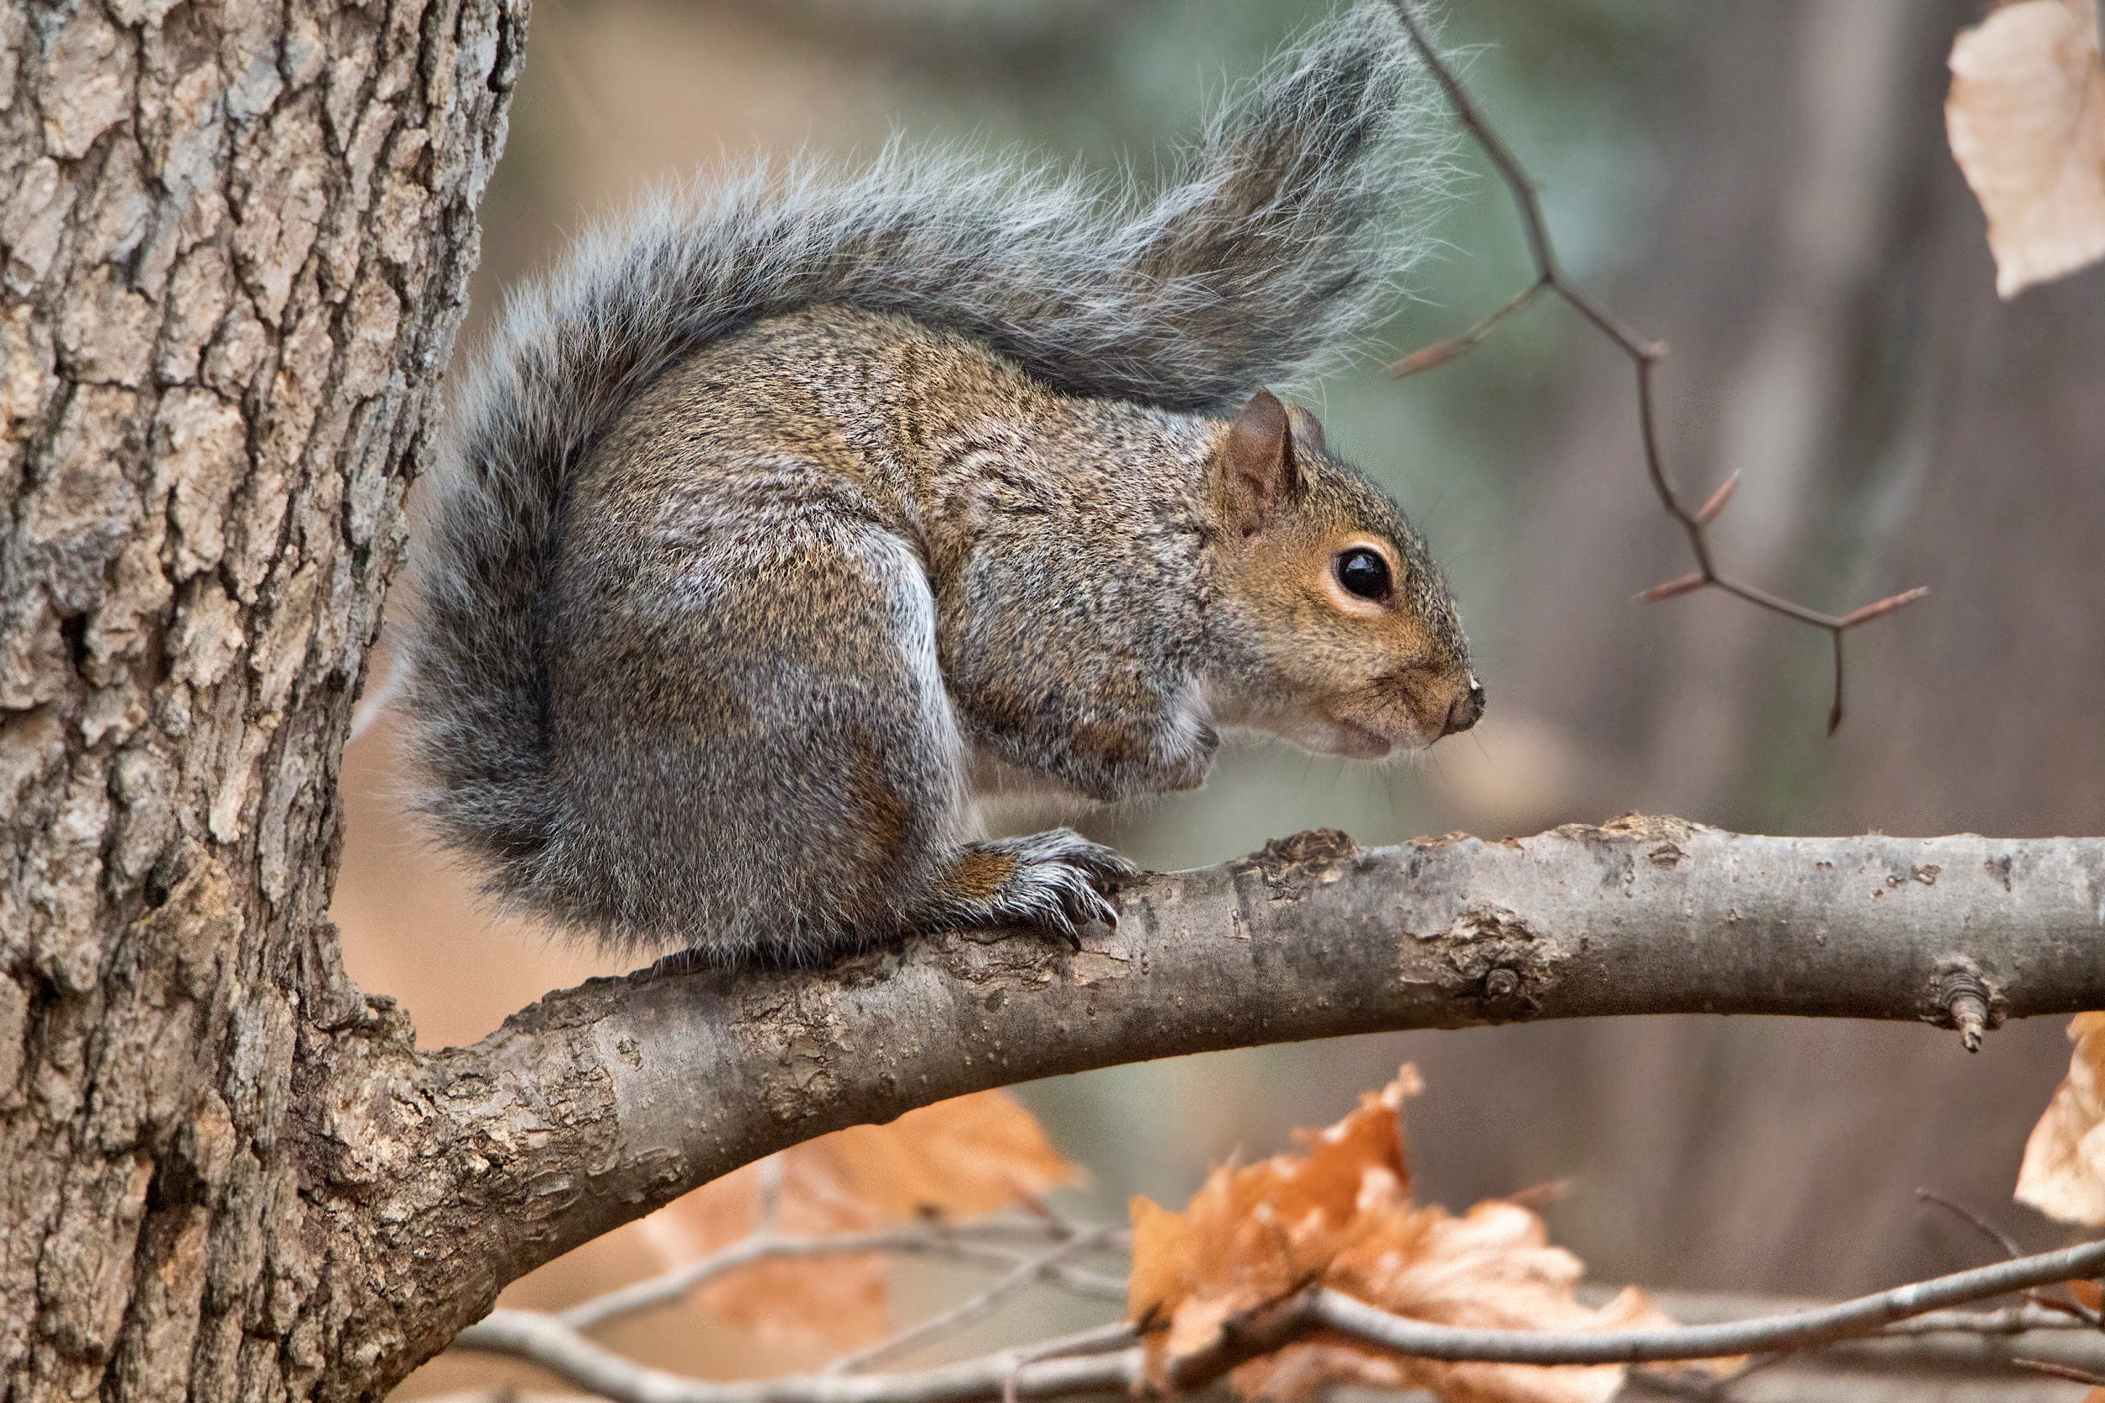
Eastern Gray Squirrel

Slide 2
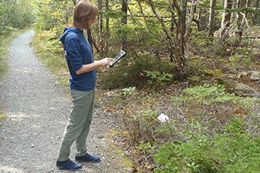
ENGAGE
Has anyone ever seen a black squirrel in their community??? What type of environment did you see it in??
https://squirrelmapper.org/

Slide 3
EXPLORE
Will Climate Change Impact the Survivorship of One Morph over the Other???

Slide 4
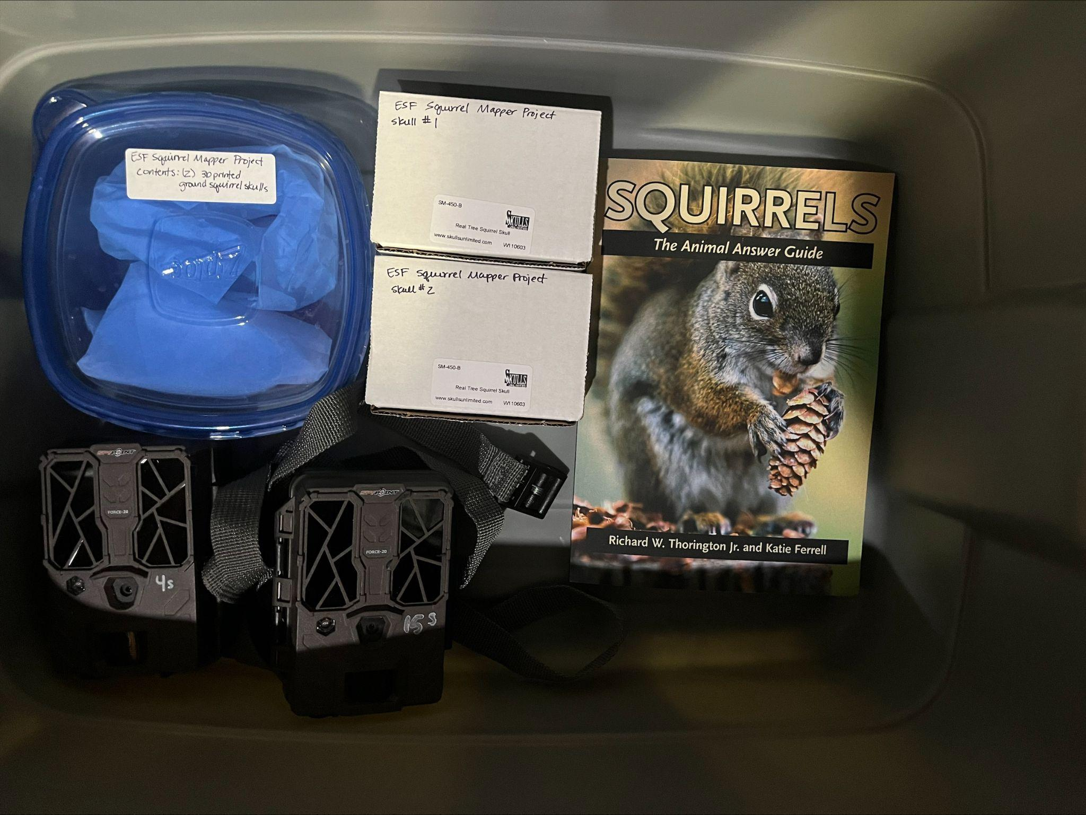
Let’s learn more about our subject!

Slide 5
Materials provided to learn more about the subjects
3D Skull of the Eastern Gray Squirrel
Actual skulls
Study Skins of both morphs
Book on history of Eastern Gray Squirrel
Trail Cams

Slide 6
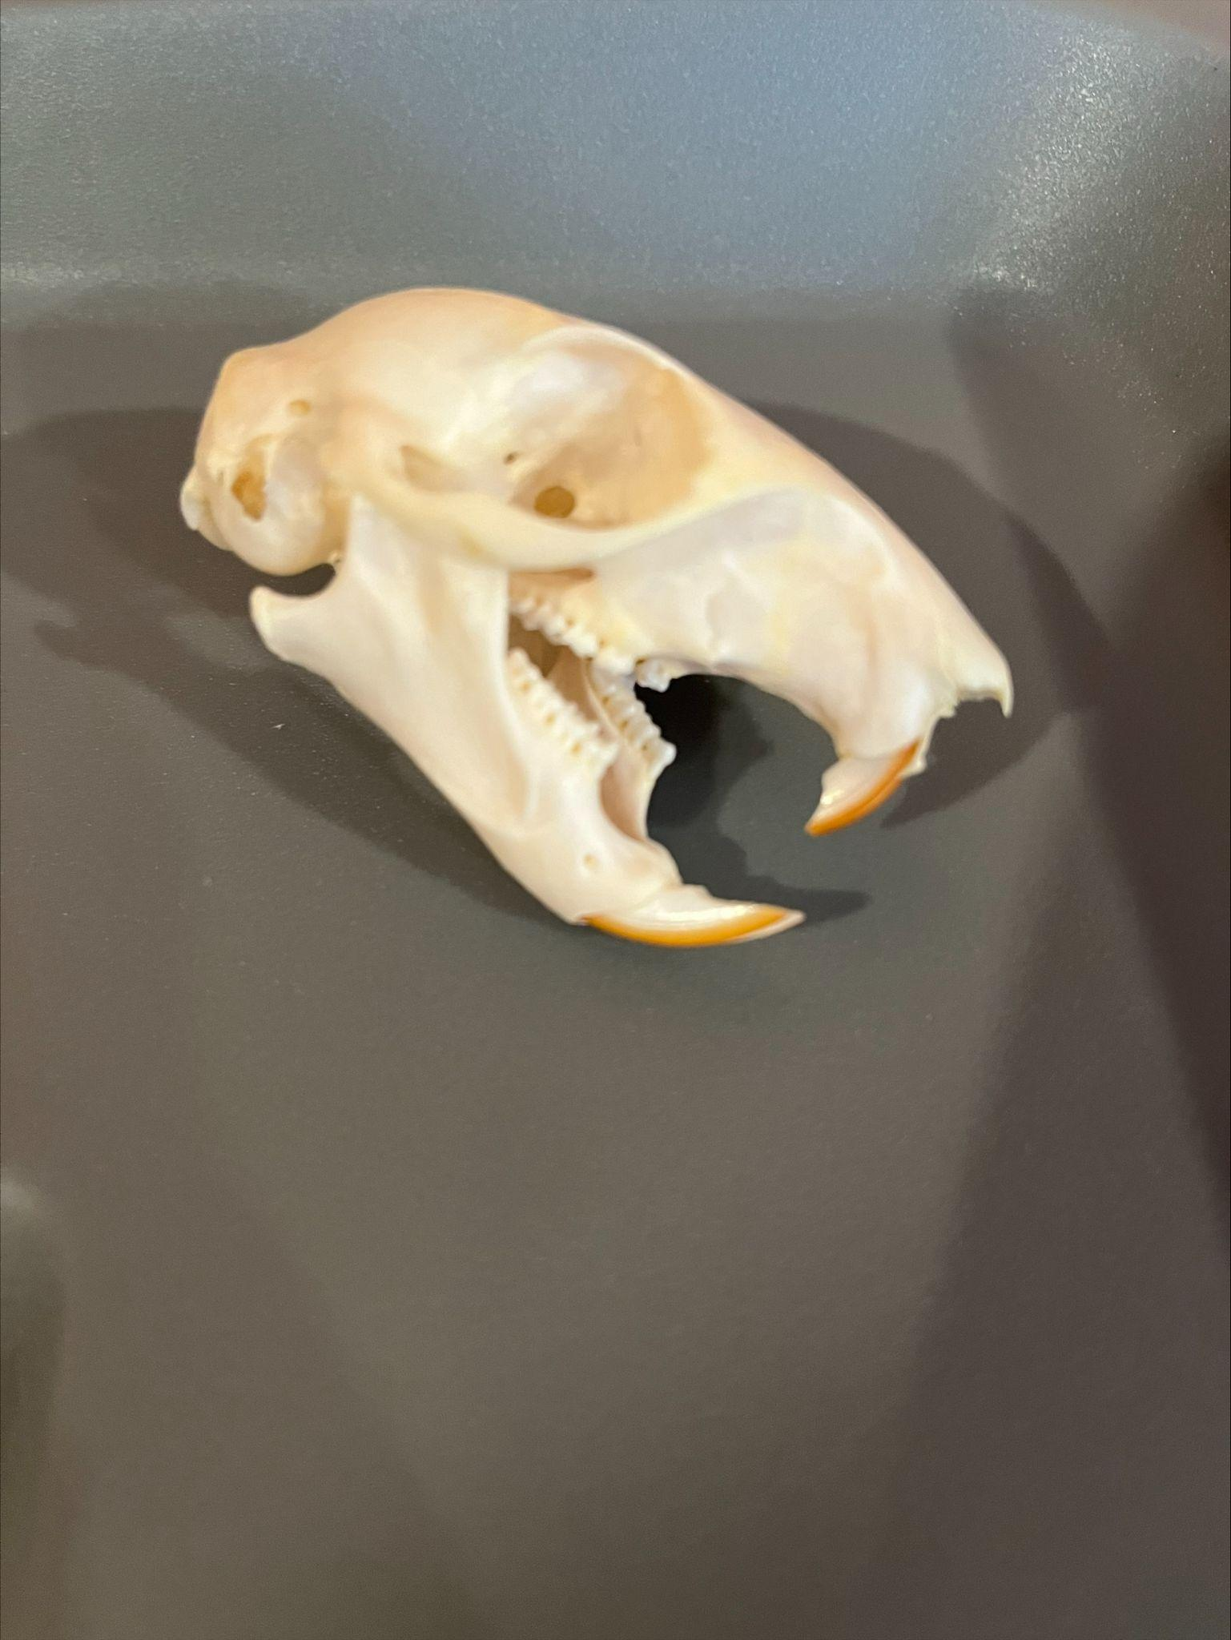
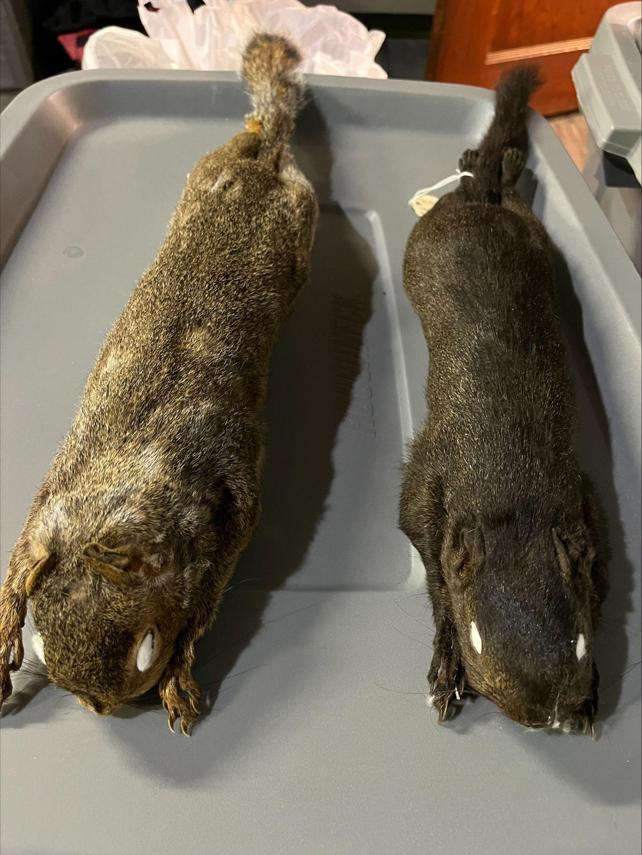

Slide 7
Explain
Jess Proctor and Adam Parlin will zoom in with students to discuss their research and answer any questions students may have regarding the color morphs of the squirrels.
Key Vocabulary:
Morphology
Urbanization
Urban Islands
Phenotype
Melanism
Gene Flow

Slide 8
Elaborate
Environmental Science Class:
Students will answer the CER question and concentrate on geographical locations; urban versus rural and color morphs of squirrels.
AP Biology Class:
Students will answer the CER question as well as discuss possible modification humans may make to the landscape due to climate change.
SUNY ESF Global Environment Class:
Students will answer the CER question as well as discuss possible modification humans may make to the landscape due to climate change

Slide 9
Evaluate
CER Rubric/Poster
Presentations
Follow Up Questions

Slide 10
Thanks!
Any questions?
You can find me at:
llowenberg@chittenangoschools.org

Slide 11
Credits
Special thanks to all the people who made and released these awesome resources:
Kara Vredenburgh
Jess Proctor
Adam Parlin

