Slide 1
Day 1
Squirrels are Awesome

Slide 2
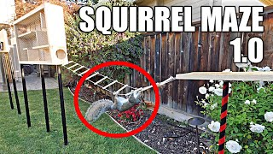
Start at 8 min watch to 11 min

Slide 3
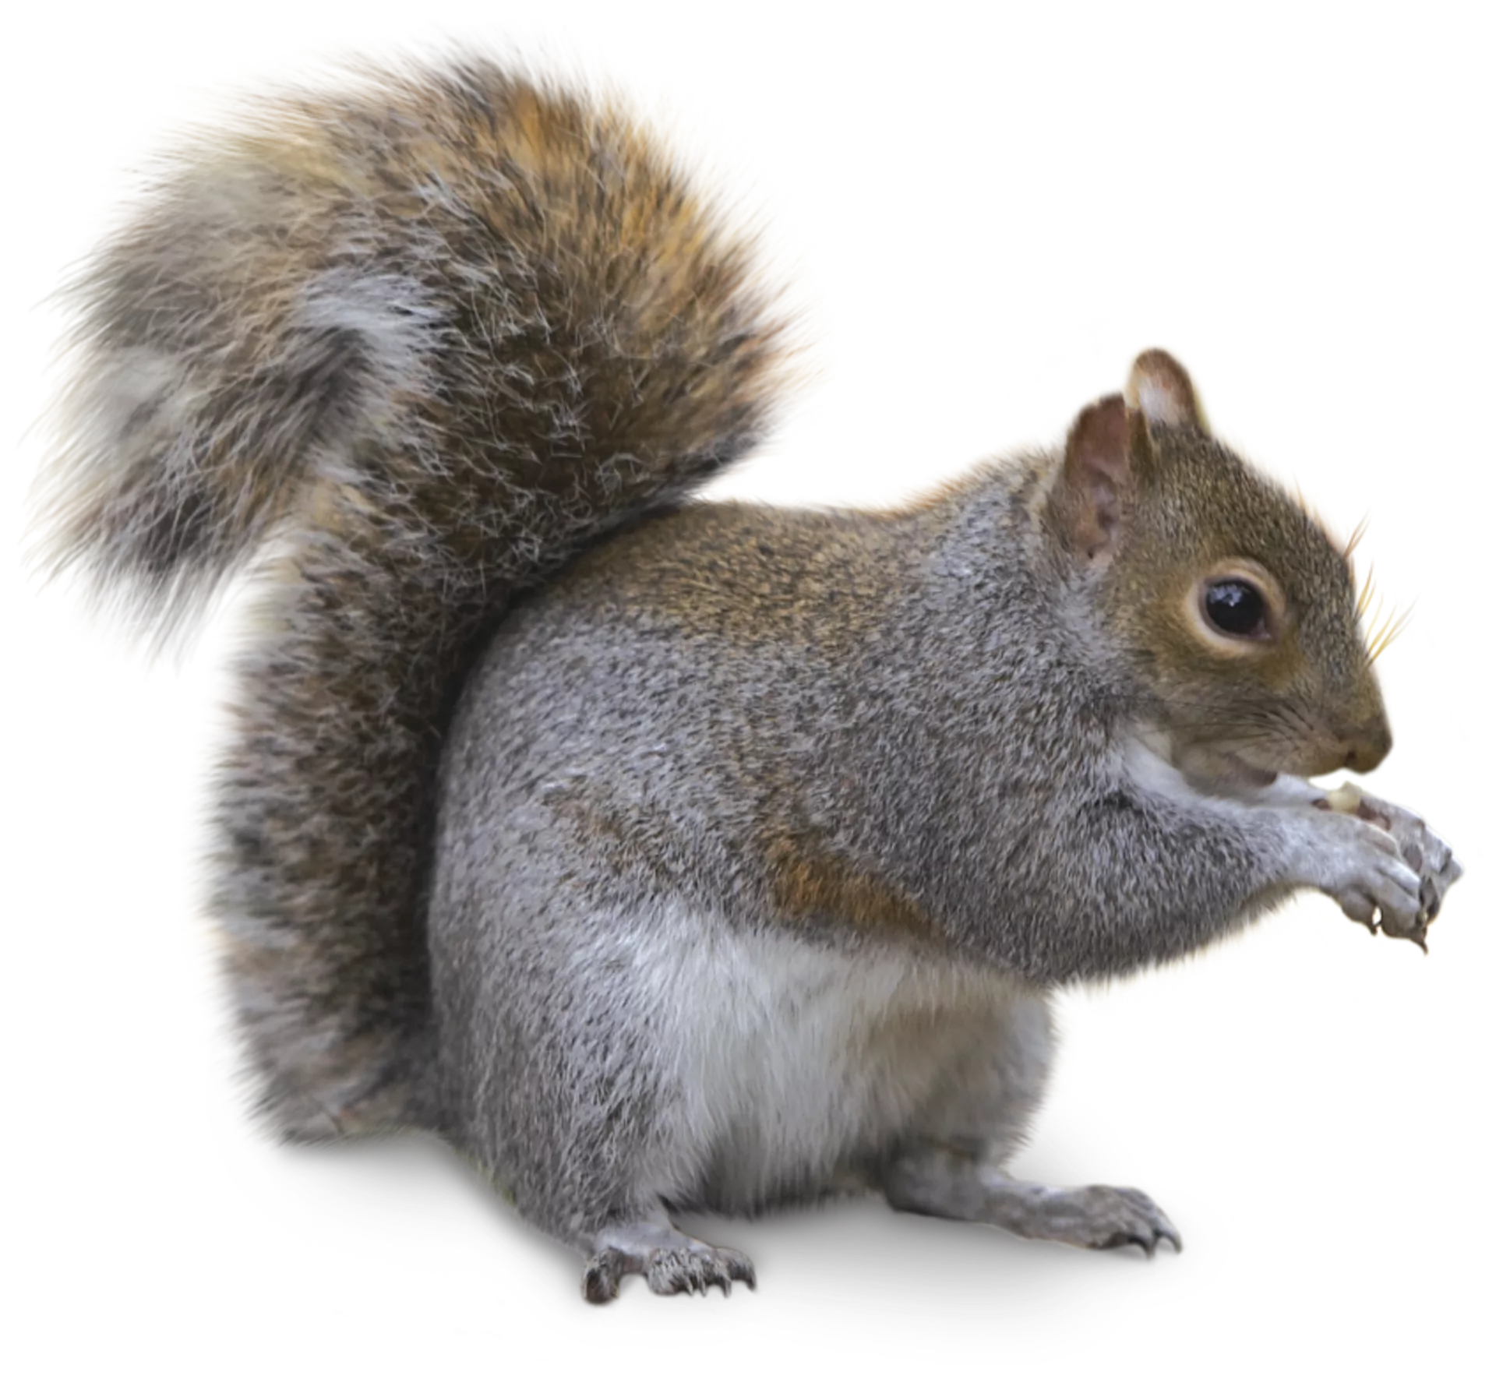
What about a squirrel helps it survive and reproduce?

Slide 4
Squirrel Stations!

