Slide 1
Evolutionary Advantage of The Eastern Gray Squirrel
AP Bio Case Study

Slide 2
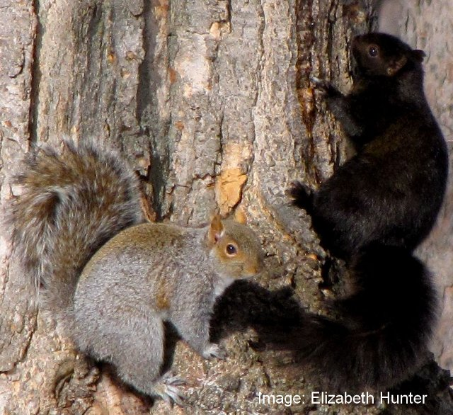
Engage: Ask students to come up with 3 questions they have when looking at these 2 squirrels?

Slide 3
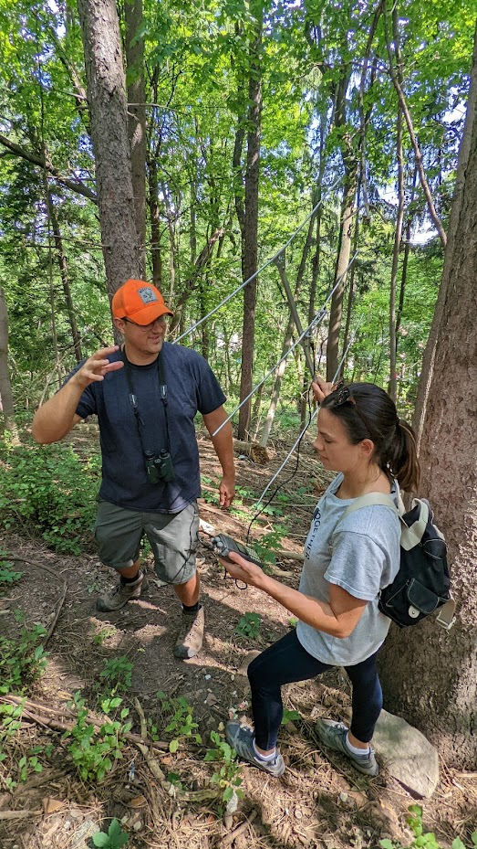
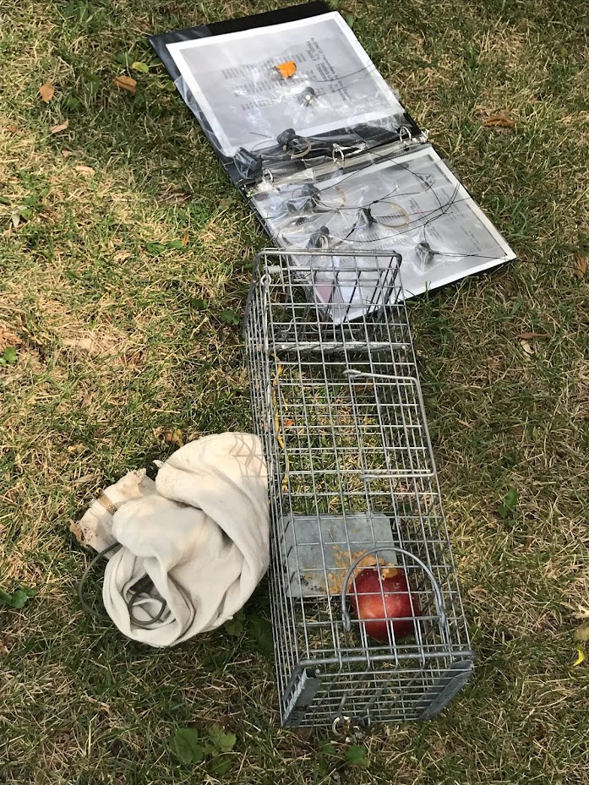
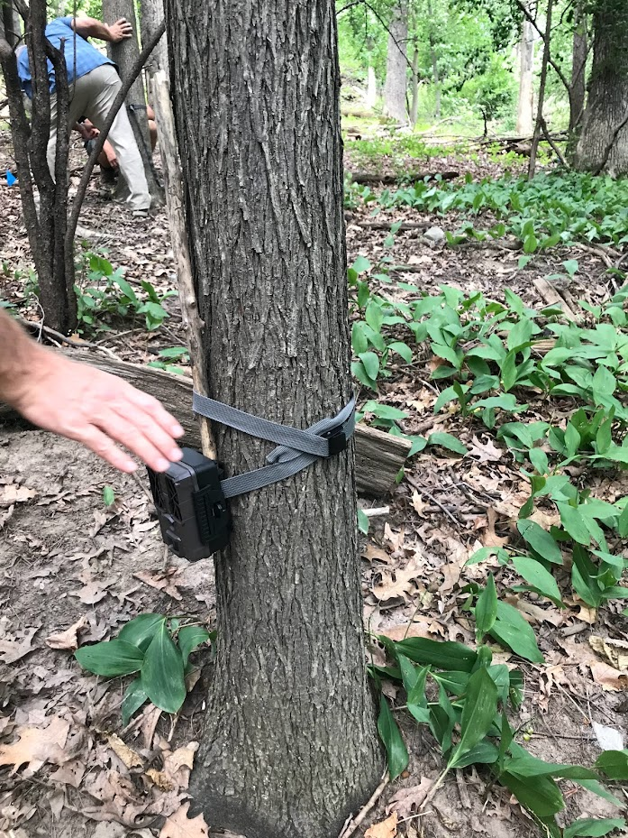
Discuss how scientists collect data to determine abundance of the different colored morphs.
Mark and recapture, sampling, point count, trail cam photos.

Slide 4
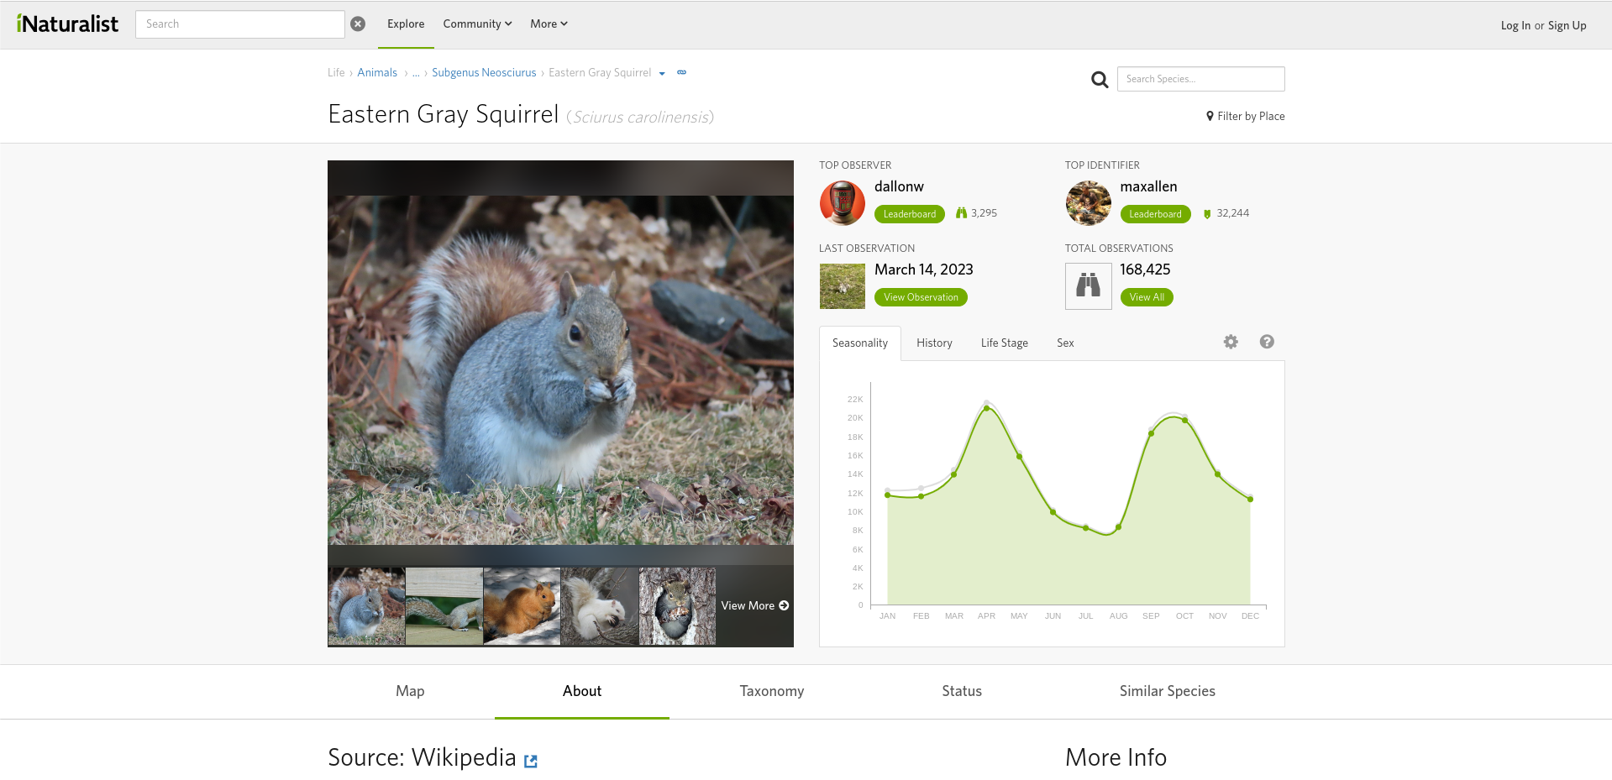
Introduce students to iNaturalist. Take students around schoolyard and practice using app.

Slide 5
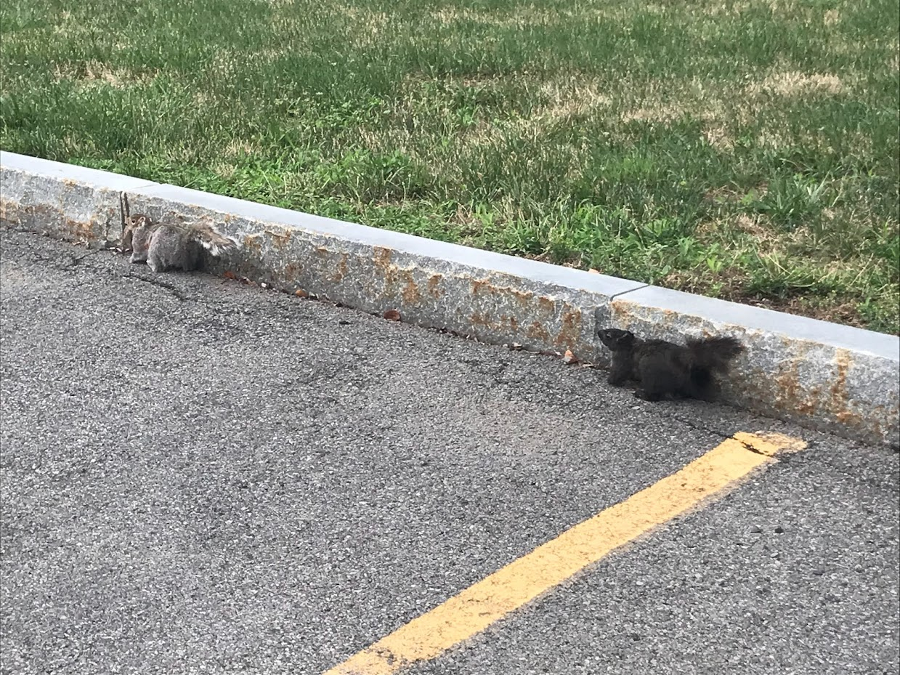
Explore: Is there an evolutionary selective/adaptive advantage for one squirrel color morph in a particular environment?
Students came up with an environment to investigate such as differences in urban vs rural, differences between cities, different sized cities, differences in cold vs warm climates, etc.
Students were then tasked with generating a claim as to the evolutionary adaptive advantage of coat color in the Eastern Gray Squirrel in a particular environment.

Slide 6
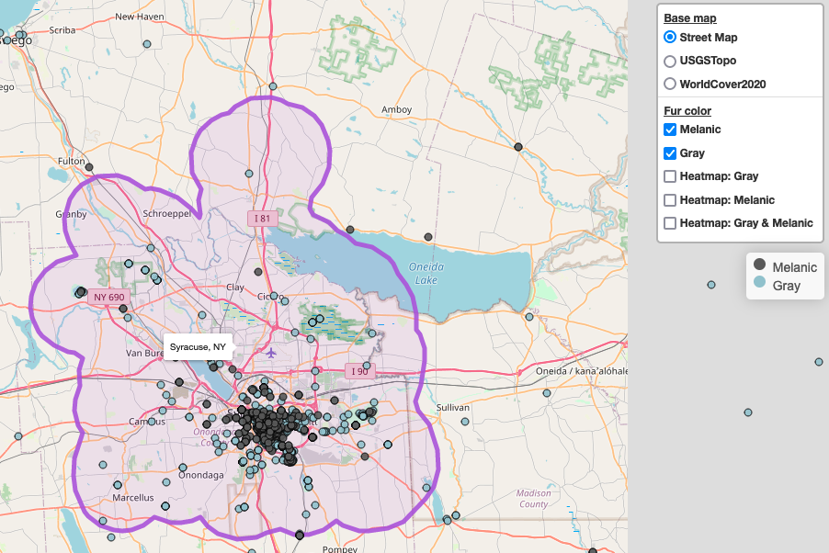
Using SquirrelMapper they were able to explore the data and apply statistical analysis (Chi-Square)

Slide 7
Student Data
 | Urban (Manhattan) | Non Urban - (Catskills)
Melanic | 99 | 2
Gray | 557 | 11
Melanic and Gray Coated Squirrels in Urban and Non-Urban Areas
The Chi-Square value was < 0, therefore the Null Hypothesis is accepted.

Slide 8
Explain: Argumentation Session
After gathering and analyzing the data the groups prepared a white board/poster where they shared their initial argument with other groups.
This was done using a round robin format.
Groups gave constructive feedback which allowed students to revise their initial argument.

Slide 9
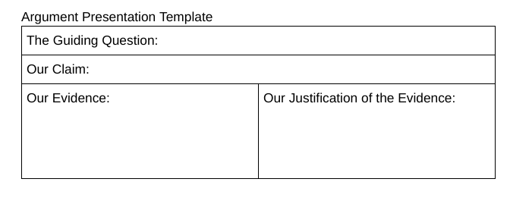
Evaluate: Using CER
Students developed a final CER using the template and then graded using a rubric.

Slide 10
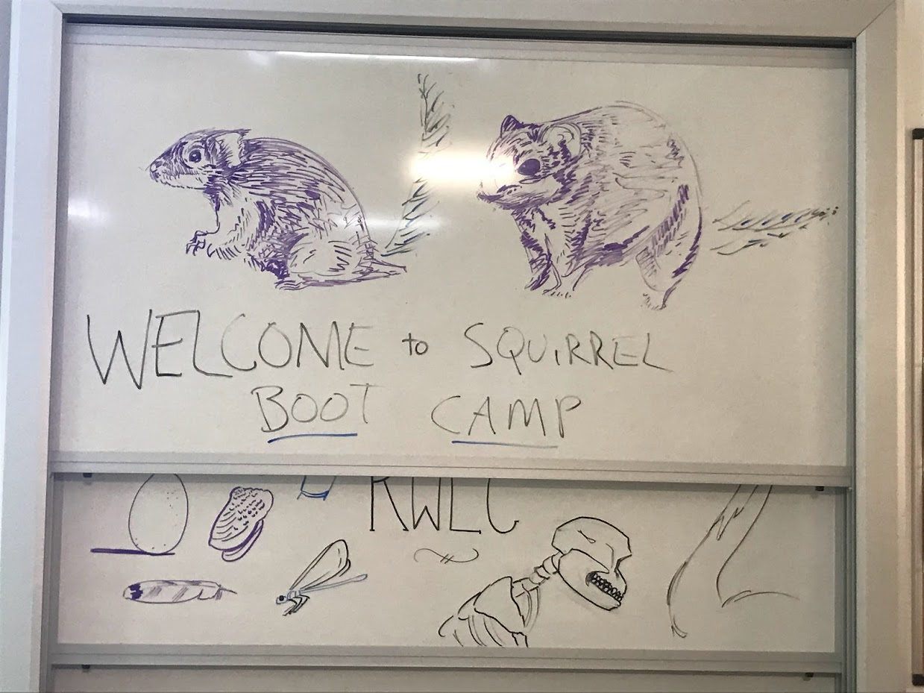
Elaborate
Colored Variation Over Time in Rock Pocket Mice Populations
https://www.biointeractive.org/classroom-resources/color-variation-over-time-rock-pocket-mouse-populations
Peppered moths of Industrial Revolution
https://askabiologist.asu.edu/activities/peppered-moth
Have students read article “The Biological System—Urban Wildlife, Adaptation, and Evolution: Urbanization as a Driver of Contemporary Evolution in Gray Squirrels (Sciurus carolinensis)” by James P. Gibbs, Matthew F. Buff, and Bradley J. Cosentino. Discuss their work and our experiences from Squirrel Boot Camp.

